Slide 1

CYBERBULLYING DETECTION USING A HYBRID RNN-LSTM MODEL

Slide 2
INTRODUCTION
This project focuses on developing a robust solution for detecting cyberbullying on social networking platforms. By leveraging the strengths of a hybrid RNN-LSTM model, the system can analyse text data and identify cyberbullying behaviour with enhanced accuracy.
Objective: The primary goal of this project is to build an automated system that identifies instances of cyberbullying on social networking platforms. Through advanced NLP techniques and machine learning algorithms, the model seeks to recognize harmful language patterns, providing a means for real-time intervention to reduce online harassment.
Scope: This project will focus on:
Collecting and pre-processing text data from social networking sites.
Building a hybrid RNN-LSTM model that can identify harmful comments and abusive language.
Testing the model’s accuracy and reliability on a dataset of social media interactions.

Slide 3
Project overview
Overview
For this project, the YouTube Data API v3 was used to collect social media data from YouTube. This API provides programmatic access to YouTube’s vast database, allowing us to retrieve video comments, which are crucial for training the cyberbullying detection model.
API Details:
YouTube Data API v3: A RESTful API that enables access to YouTube resources like videos, playlists, and comment threads.
Purpose:
To collect social media posts, comments, and interactions that may contain instances of cyberbullying.
To create a comprehensive dataset for training the RNN-LSTM model.

Slide 4
DATA COLLECTION
DATA RETRIEVAL
API INTEGRATION:
UTILIZED THE YOUTUBE DATA API V3 TO RETRIEVE VIDEO COMMENTS.
AUTHENTICATION: GENERATED AN API KEY FROM GOOGLE CLOUD CONSOLE FOR ACCESSING THE API.
DATA SOURCES
VIDEO IDENTIFICATION:
DATA WAS COLLECTED USING SPECIFIC VIDEO IDS, KEYWORDS, OR CHANNEL NAMES TO FOCUS ON RELEVANT CONTENT.
USED YOUTUBE SEARCH API TO IDENTIFY VIDEOS RELATED TO CYBERBULLYING OR SPECIFIC TOPICS OF INTEREST.
DATA FETCHING PROCESS
FETCHING COMMENTS:
THE COMMENTTHREADS ENDPOINT OF THE YOUTUBE API WAS USED TO COLLECT COMMENTS FOR EACH IDENTIFIED VIDEO.
PAGINATION: IMPLEMENTED PAGINATION TO FETCH MORE THAN 100 COMMENTS BY USING THE NEXTPAGETOKEN PROVIDED BY THE API.
HANDLING RATE LIMITS
API QUOTA MANAGEMENT:
API RATE LIMITS WERE MANAGED BY LIMITING THE NUMBER OF REQUESTS MADE PER DAY.
IMPLEMENTED BACK-OFF STRATEGIES WHEN RATE LIMITS WERE REACHED TO PREVENT QUOTA EXHAUSTION.
DATA STORAGE
STORING DATA:
THE COLLECTED DATA WAS STORED IN CSV FORMAT, CAPTURING KEY ATTRIBUTES LIKE COMMENT TEXT, USER ID, TIMESTAMP, AND VIDEO ID

Slide 5
Text preprocessing techniques
1. Tokenization: Split the raw text (comments) into individual tokens (words).
Tools: Used NLP libraries like NLTK or spaCy.
Example:
Input: "I love programming!"
Tokens: ["I", "love", "programming"]
2. Lemmatization: Reduced words to their base form (lemma), considering the context (e.g., verb tense or plurality).
Tools: NLTK's WordNetLemmatizer or spaCy.
Example:
Input: ["running", "ran", "runner"]
Lemma: ["run", "run", "run"]
3. Stemming: Removed prefixes and suffixes from words to reduce them to their root form.
Tools: NLTK's PorterStemmer or LancasterStemmer.
Example:
Input: ["running", "runner", "runs"]
Stem: ["run", "run", "run"] (Note: might result in non-dictionary words)

Slide 6
Data Labelling
Data Cleaning
Remove Noise: Eliminated URLs, emojis, hashtags, and special characters.
Normalize Text: Converted text to lowercase, removed punctuation, and tokenized sentences.
Stop Word Removal: Filtered out common words (e.g., "the", "and") that don’t add meaning.
Handle Missing Data: Discarded incomplete comments or used placeholders for missing values.
Data Labeling
Labeling Categories:
0: Non-Cyberbullying (Neutral or positive comments)
1: Cyberbullying (Offensive language, harassment, or threats)
Labeling Process:
Manual & Assisted Labeling: Combined manual labeling with rule-based algorithms.
Quality Control: Regular checks to ensure consistency and accuracy.

Slide 7
Stages Evaluation
stage 1: Web Scraping & Preprocessing
Collected data using YouTube Data API v3 to fetch comments from videos.
Cleaned and preprocessed the data by removing noise, normalizing text, and tokenizing sentences.
stage 2: Data Labelling
Labelled data into two categories:
0: Non-Cyberbullying (Neutral/Positive)
1: Cyberbullying (Offensive/Harassing)
Manual and assisted labelling techniques ensured accurate categorization.
stage 3: Splitting Data & Model Training
Split the labelled dataset into training and testing sets.
Trained the model with Machine LEARNING models (e.g., HYBRID RNN-LSTM) to evaluate performance.
stage 4: Creating GUI with Flask & Testing
Developed a Flask-based GUI for user interaction and model testing.
Integrated the trained model into the web interface and conducted testing on new data.

Slide 8
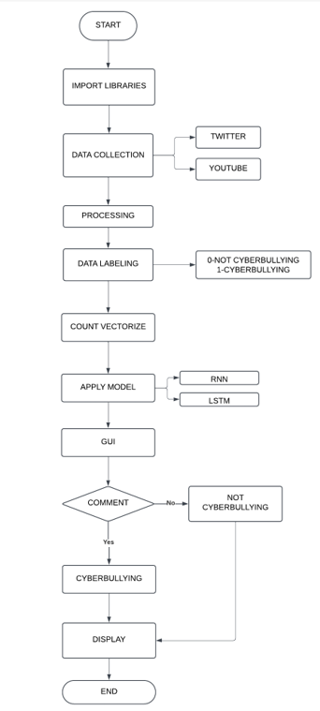
Flowchart

Slide 9
SOFTWARE REQUIREMENTS
1. Operating System:
Windows 10/11 (64-bit) or macOS/Linux.
2. Libraries and Frameworks:
TensorFlow (v2.18.0)
Keras (v3.6.0)
NLTK (v3.8.1)
NumPy (v1.26.4)
Pandas (v2.2.2)
scikit-learn (v1.4.2)
Matplotlib (v3.8.4)
Seaborn (v0.13.2)
3. Frontend/Backend Development:
HTML5, CSS3, Bootstrap (v5.3.3), Flask (v3.0.3), VS Code (v1.95.3)
4. Development Environment:
Jupyter Notebook, Google Colab, GitHub
5. API Access:
YouTube Data API V3 (Google API key required).

Slide 10
RECURRENT NEURAL NETWORK (RNN)
SEQUENTIAL DATA HANDLING: DESIGNED TO PROCESS AND PREDICT ON SEQUENTIAL DATA, SUCH AS TIME-SERIES OR TEXT, BY MAINTAINING A MEMORY OF PREVIOUS INPUTS.
CONTEXT UNDERSTANDING: CAPTURES CONTEXTUAL DEPENDENCIES WITHIN SEQUENCES BY SHARING WEIGHTS ACROSS TIME STEPS.
LIGHTWEIGHT ARCHITECTURE: SIMPLER THAN ADVANCED MODELS LIKE LSTMS OR GRUS, MAKING IT FASTER FOR SHORT SEQUENCES.
APPLICATIONS: USED IN VARIOUS TASKS SUCH AS LANGUAGE MODELING, MACHINE TRANSLATION, SPEECH RECOGNITION, AND TEXT GENERATION.
SHARED WEIGHTS: UTILIZES THE SAME SET OF WEIGHTS ACROSS ALL TIME STEPS, ENSURING CONSISTENCY AND REDUCING THE NUMBER OF PARAMETERS.
EASY TO IMPLEMENT: SIMPLE ARCHITECTURE MAKES IT EASIER TO IMPLEMENT AND UNDERSTAND COMPARED TO MORE COMPLEX MODELS.
CHALLENGES:
SUFFERS FROM THE VANISHING GRADIENT PROBLEM IN LONG SEQUENCES.
LIMITED ABILITY TO RETAIN LONG-TERM DEPENDENCIES.
MEMORY CAPACITY IS RESTRICTED BY ITS ARCHITECTURE, AFFECTING THE CAPTURE OF DISTANT DEPENDENCIES.
STRUGGLES WITH VERY LONG SEQUENCES, LEADING TO POOR PERFORMANCE IN TASKS REQUIRING LONG-TERM MEMORY.

Slide 11
LONG SHORT-TERM MEMORY (LSTM)
HANDLES LONG-TERM DEPENDENCIES: OVERCOMES THE VANISHING GRADIENT PROBLEM IN RNNS BY USING GATES (INPUT, FORGET, AND OUTPUT) TO SELECTIVELY REMEMBER OR FORGET INFORMATION.
FLEXIBILITY: EFFECTIVE FOR BOTH SHORT-TERM AND LONG-TERM SEQUENCE DEPENDENCIES.
ROBUST TO SEQUENCE LENGTH: WORKS WELL WITH BOTH SHORT AND LONG SEQUENCES OF DATA.
APPLICATIONS: WIDELY USED IN TASKS LIKE TEXT GENERATION, MACHINE TRANSLATION, AND SPEECH RECOGNITION.
GATED MECHANISM: UTILIZES GATES TO CONTROL THE FLOW OF INFORMATION, ENABLING THE MODEL TO KEEP OR DISCARD INFORMATION AS NEEDED.
HIGH-CAPACITY MEMORY: ABLE TO STORE INFORMATION OVER LONGER SEQUENCES COMPARED TO SIMPLE RNNS.
TRADE-OFFS:
COMPUTATIONALLY MORE EXPENSIVE THAN SIMPLE RNNS.
REQUIRES MORE RESOURCES (E.G., TRAINING TIME AND MEMORY).
ADVANCED ARCHITECTURE: MORE COMPLEX THAN BASIC RNNS, LEADING TO BETTER PERFORMANCE IN HANDLING LONGER DEPENDENCIES BUT AT THE COST OF INCREASED COMPUTATIONAL DEMANDS.

Slide 12
Accuracy OF RNN AND LSTM
LSTM: RNN:
TESTSIZE | PADDING(PRE) | PADDING(POST)
0.2 | 0.8460 | 0.5960
0.25 | 0.8395 | 0.6227
0.3 | 0.8469 | 0.6014
TESTSIZE | PADDING(PRE) | PADDING(POST)
0.2 | 0.8277 | 0.8277
0.25 | 0.8329 | 0.8329
0.3 | 0.8110 | 0.6014

Slide 13
Accuracy OF OTHER MODELS
MODEL NAME | 0.2 | 0.25 | 0.3
Random Forest classifier | 0.8479 | 0.8440 | 0.8454
Logistic Regression | 0.8576 | 0.8511 | 0.8544
Naive Bayes | 0.8091 | 0.8068 | 0.8076
Support vector machine | 0.8538 | 0.8520 | 0.8512

Slide 14
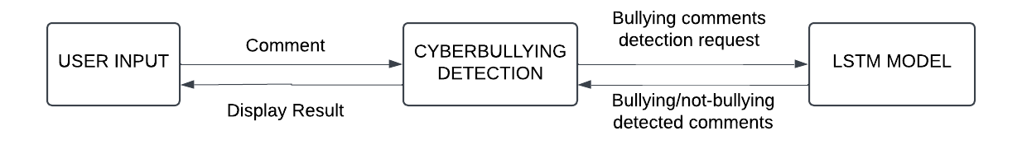
FRONT END WORKING
USER INPUT: THE USER PROVIDES A COMMENT.
CYBERBULLYING DETECTION MODULE: THIS MODULE RECEIVES THE COMMENT AND SENDS IT TO THE LSTM (LONG SHORT-TERM MEMORY) MODEL FOR ANALYSIS.
LSTM MODEL: THE MODEL PROCESSES THE INPUT AND CLASSIFIES IT AS EITHER BULLYING OR NOT-BULLYING.
RESULTS DISPLAY: THE DETECTED CATEGORY (BULLYING OR NOT-BULLYING) IS RETURNED AND DISPLAYED TO THE USER.

Slide 15
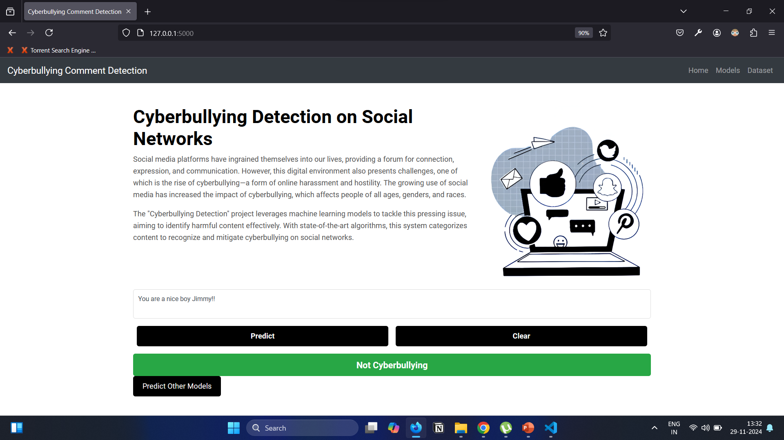
GUI USING FLASK

Slide 16
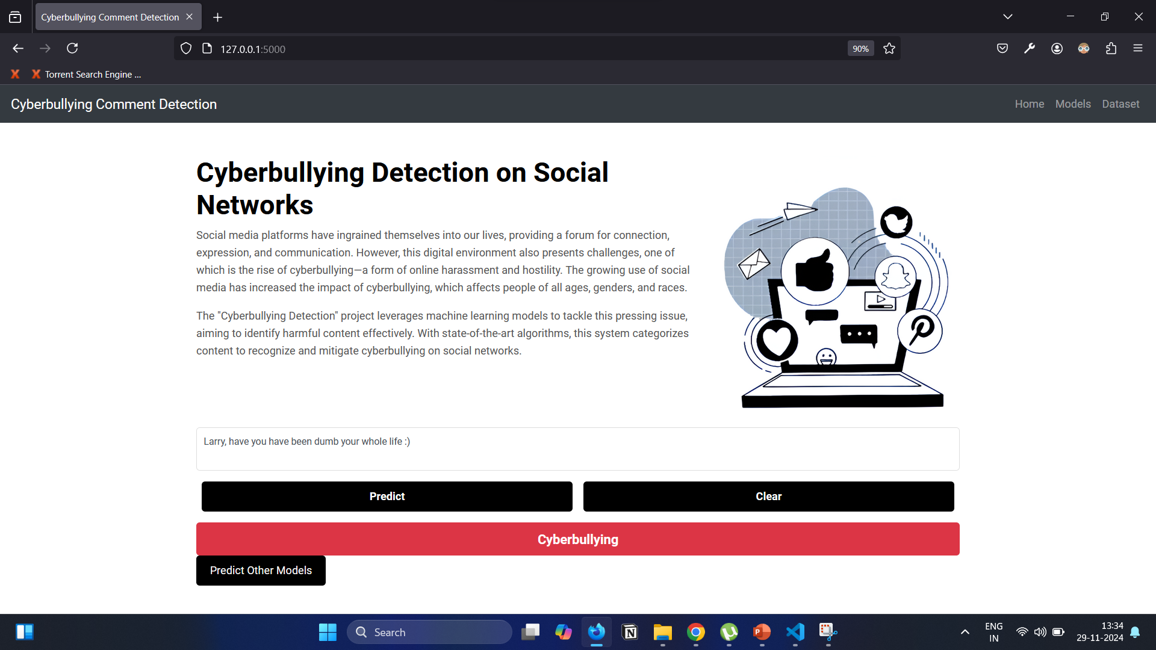
GUI USING FLASK

Slide 17
CONCLUSION
Project Overview:
Focused on detecting cyberbullying on social media platforms like YOUTUBE, X and Instagram using web scraping and a Hybrid RNN-LSTM model for text classification.
Model Training:
Train models using multiple algorithms to compare performance:
Hybrid RNN-LSTM
Logistic Regression
Random Forest
Naive Bayes
SUPPORT VECTOR MACHINE
Model Evaluation:
Evaluate the models using metrics such as Accuracy, F1-Score, MSE, and MAE.
Compare model performance to identify the most effective approach.
End Goal:
Deploy the best-performing model for real-time cyberbullying detection in social media platforms.

Slide 18
TEAM MEMBERS
AASHAY SANJAY PATIL
RAMA DIVYA
GAJJALA NEHA PRANAVI

